Slide 1

ZooKeeper
Dima Ionut Daniel

Slide 2
Contents
What is ZooKeeper?
Distributed Systems
Architecture
Watches
ACL
Configuration
Clustering
Core
Administration
Apache Curator
Zookeeper in Action
Conclussion
Bibliography

Slide 3

What is ZooKeeper?
Apache ZooKeeper is a software project of the Apache Software Foundation.
Open source distributed configuration service, synchronization service and naming registry for large distributed systems.
ZooKeeper's architecture supports high-availability through redundant services.
ZooKeeper is used by companies including Rackspace, Yahoo and eBay as well as open source enterprise search systems like Solr.

Slide 4
What is ZooKeeper? (cont.)
ZooKeeper can be used to implement common distributed coordination tasks:
Configuration management
Naming service
Distributed synchronization, such as locks and barriers
Cluster membership operations, such as detection of node leave/node join

Slide 5
Distributed Systems
A distributed system:
composed of independent computing entities linked together
the components communicate/coordinate with each other
Example of distributed systems: Gmail, Yahoo, Multiplayer online gaming.

Slide 6
Distributed Systems (cont.)
Distributed system characteristics:
Resource sharing: storage space, computing power, data, and services.
Extendibility: possibility of extending and improving the system incrementally.
Concurrency: system's capability to be used by multiple users at the same time.
Performance and scalability: ensures that the response time of the system doesn't degrade as the overall load increases.
Fault tolerance: ensures availability even if some of the components fail or operate in a degraded mode.
Abstraction through APIs: system's individual components are concealed from the end users, revealing only the end services to them.

Slide 7
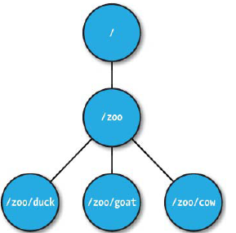
Architecture
ZooKeeper allows distributed processes to coordinate with each other through a shared hierarchical namespace of data registers.
The namespace looks quite similar to a Unix filesystem.
The data registers are known as znodes in the ZooKeeper nomenclature.
Znodes are organized hierarchically like a tree as a standard filesystem.
The znodes are called data registers because they can store data.

Slide 8
Architecture (cont.)
The data in a znode is typically stored in a byte format, with a maximum data size in each znode of no more than 1 MB.
ZooKeeper is designed for coordination, and almost all forms of coordination data are relatively small in size
It is recommended that the actual data size be much less than this limit as well.
Like files in a filesystem, znodes maintain a stat structure that includes version numbers for data changes and an access control list that changes along with timestamps associated with changes.
The version number increases whenever the znode's data changes.

Slide 9
Architecture (cont.)
ZooKeeper has two types of znodes: persistent and ephemeral.
Both persistent and ephemeral znodes can be sequential znodes as well.
A znode's type is set at its creation time.
Persistent znodes have a lifetime in the ZooKeeper's namespace until they're explicitly deleted.
A znode can be deleted by calling the delete API call.
[zk: localhost(CONNECTED) 1] create /[Test] "ApacheZooKeeper"
Created /[Test]
[zk: localhost(CONNECTED) 2] get /[Test]
"ApacheZooKeeper"

Slide 10
Architecture (cont.)
Since both persistent and ephemeral znodes can be sequential znodes, we have a total of four modes of znodes:
persistent
ephemeral
persistent_sequential
ephemeral_sequential

Slide 11
Architecture (cont.)
To create a sequential znode using the ZooKeeper Java shell, we have to use the –s flag of the create command:
[zk: localhost(CONNECTED) 1] create -s /[Test] "PersistentSequentialZnode"
Created /[Test]0000000001
[zk: localhost(CONNECTED) 3] create -s -e /[Test] "EphemeralSequentialZnode"
Created /[Test]0000000008

Slide 12
Architecture (cont.)
An ephemeral znode is deleted by the ZooKeeper service when the creating client's session ends.
An end to a client's session can happen because of disconnection due to a client crash or explicit termination of the connection.
Even though ephemeral nodes are tied to a client session, they are visible to all clients,depending on the configured Access Control List (ACL) policy.
An ephemeral znode can also be explicitly deleted by the creator client or any other authorized client by using the delete API call.
An ephemeral znode is not allowed to have children.

Slide 13
Watches
ZooKeeper designers implemented a mechanism where clients can get notifications from the ZooKeeper service instead of polling for events.
This resembles a push model, where notifications are pushed to the registered clients of the ZooKeeper service.
Clients can register with the ZooKeeper service for any changes associated with a znode.

Slide 14
Watches (cont.)
This registration is known as setting a watch on a znode in ZooKeeper terminology.
Watches allow clients to get notifications when a znode changes in any way.
A watch is a one-time operation, which means that it triggers only one notification.
To continue receiving notifications over time, the client must reregister the watch upon receiving each event notification.

Slide 15
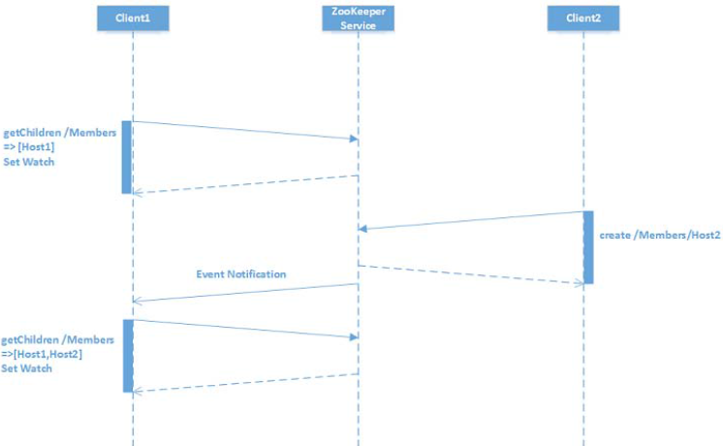
Watches (cont.)

Slide 16
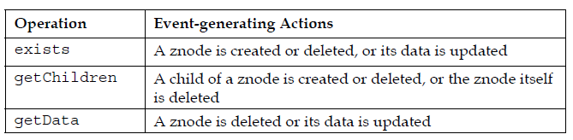
Watches (cont.)
The following are the types of watch events that might occur during a znode state change:
NodeChildrenChanged: A znode's child is created or deleted
NodeCreated: A znode is created in a ZooKeeper path
NodeDataChanged: The data associated with a znode is updated
NodeDeleted: A znode is deleted in a ZooKeeper path

Slide 17
ACL
ZooKeeper's data model provides a mechanism to control the access to znodes using ACL.
The ZooKeeper ACL model is similar to the Unix/Linux file permissions in terms of permitting or preventing operations being done on a znode by setting/unsetting permission bits.
The ZooKeeper node doesn't have the concept of ownership, which is present in the Unix/Linux filesystem.

Slide 18
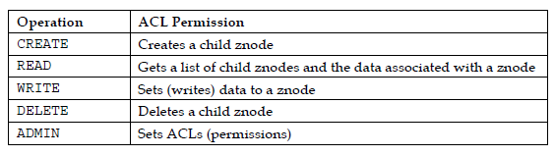
ACL (cont.)
ZooKeeper provides the following built-in authentication mechanisms based on ACLs:
World: represents anyone who is connecting to the ZooKeeper service
Auth: represents any authenticated user, but doesn't use any ID
Digest: represents the username and password way of authentication
IP address: represents authentication with the IP address of the client

Slide 19
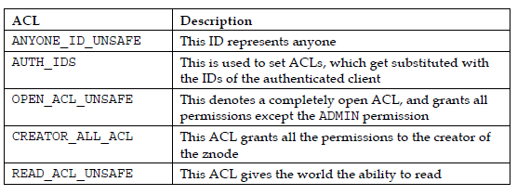
ACL (cont.)
There are a number of predefined ACLs in ZooKeeper:

Slide 20
ACL (cont.)
Every znode in ZooKeeper's namespace has a stat structure:
cZxid: transaction ID of the change that caused this znode to be created.
mZxid: transaction ID of the change that last modified this znode.
pZxid: transaction ID for a znode change that pertains to adding or removing children.
ctime: creation time of a znode in milliseconds from epoch.
mtime: last modification time of a znode in milliseconds from epoch.
dataVersion: number of changes made to the data of this znode.
cversion: number of changes made to the children of this znode.
aclVersion: number of changes made to the ACL of this znode.
ephemeralOwner: session ID of the znode's owner if the znode is an ephemeral node. If the znode is not an ephemeral node, this field is set to zero.
dataLength: length of the data field of this znode.
numChildren: number of children of this znode.

Slide 21
Configuration
The conf folder contains the configuration files for ZooKeeper.
ZooKeeper needs a configuration file called zoo.cfg.
Minimal sample ocnfiguration:
$ cat conf/zoo.cfg
tickTime=2000
dataDir=/var/lib/zookeeper
clientPort=2181

Slide 22
Configuration (cont.)
tickTime: represents session registration and to do regular heartbeats by clients with the ZooKeeper service.
dataDir: location to store the in-memory state of ZooKeeper;
clientPort: port that listens for client connections. The default is 2181.
Apache Zookeeper can be started using the zkServer script.
We can connect to Zookeeper using the zkCli script.
Example: zkCli.sh -server localhost:2181

Slide 23
Configuration (cont.)
tickTime: represents session registration and to do regular heartbeats by clients with the ZooKeeper service.
dataDir: location to store the in-memory state of ZooKeeper;
clientPort: port that listens for client connections. The default is 2181.
Apache Zookeeper can be started using the zkServer script.
We can connect to Zookeeper using the zkCli script.
Example: zkCli.sh -server localhost:2181

Slide 24
Configuration (cont.)
[zk: localhost:2181(CONNECTED) 1] ls /
[zookeeper]
The ls command returned a string called zookeeper, which is a znode in the ZooKeeper terminology.
[zk: localhost:2181(CONNECTED) 2] create /HelloWorld ""
Created /HelloWorld
[zk: localhost:2181(CONNECTED) 3] ls /
[zookeeper, HelloWorld]
[zk: localhost:2181(CONNECTED) 4] delete /HelloWorld
[zk: localhost:2181(CONNECTED) 5] ls /
[zookeeper]

Slide 25
Clustering
Default ZooKeeper server instance has standalone mode.
A standalone instance is a potential single point of failure.
In a production environment, ZooKeeper should be run on multiple servers in a replicated mode(ZooKeeper ensemble).

Slide 26
Clustering (cont.)
The replicated group of servers in the same application domain is called a quorum.
In this mode, the ZooKeeper server instance runs on multiple different machines, and all servers in the quorum have copies of the same configuration file.
In a quorum, ZooKeeper instances run in a leader/follower format.
One of the instances is elected the leader, and others become followers.

Slide 27
Clustering (cont.)
The ZooKeeper configuration file for a multinode mode:
tickTime=2000
dataDir=/var/lib/zookeeper
clientPort=2181
initLimit=5
syncLimit=2
server.1=zoo1:2888:3888
server.2=zoo2:2888:3888
server.3=zoo3:2888:3888

Slide 28
Clustering (cont.)
initLimit: timeout, specified in number of ticks, for a follower to initially connect to a leader
syncLimit: timeout, specified in number of ticks, for a follower to sync with a leader
In the example, the timeout for initLimit is 5 ticks at 2000 milliseconds a tick, or 10 seconds.
We have the two port numbers after each server hostname: 2888 and 3888.
The first port, 2888, is used for peer-to-peer communication in the quorum, such as to connect followers to leaders.
A follower opens a TCP connection to the leader using this port.
The second port, 3888, is used for leader election, in case a new leader arises in the quorum.

Slide 29
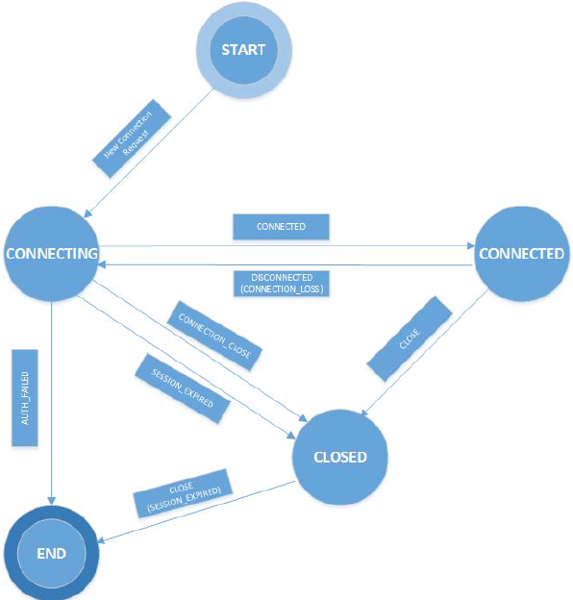
Core
The Zookeeper client has the following states:

Slide 30
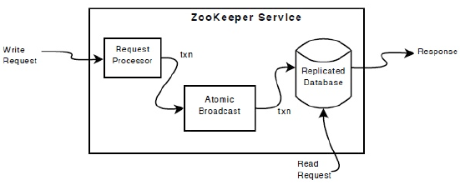
Core (cont.)
In cluster mode a server is elected as a leader, and all the remaining servers are made followers.
The leader handles all requests that change the ZooKeeper service.
Followers receive the updates proposed by the leader, and through a majority consensus mechanism.
ZooKeeper uses a special atomic messaging protocol called ZooKeeper Atomic Broadcast (ZAB).
This protocol ensures that the local replicas in the ensemble never diverge.
Also, the ZAB protocol is atomic, so the protocol guarantees that updates either succeed or fail.

Slide 31
Core (cont.)
A ZooKeeper transaction also comprises all the steps required to successfully execute the request as a single work unit, and the updates are applied atomically.
A transaction satisfies the property of isolation.
A transaction in the ZooKeeper service is idempotent.
Transactions are identified by a transaction identifier (zxid), which is a 64-bit integer split into two parts: the epoch and the counter, each being 32 bits.

Slide 32
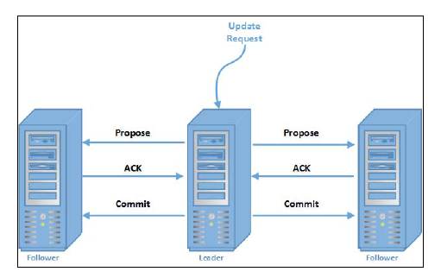
Core (cont.)
Transaction processing involves two steps in ZooKeeper: leader election and atomic broadcast.
All write requests in ZooKeeper are forwarded to the leader.
ZAB guarantees strict ordering in the delivery of transactions as well as in the committing of the transactions.

Slide 33
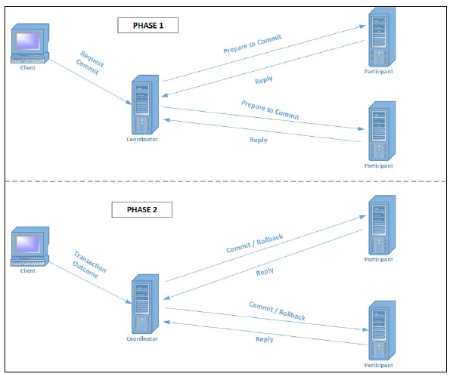
Core (cont.)

Slide 34

Core (cont.)
Watches enable a client to receive notifications from the ZooKeeper server and process these events upon occurrence.
ZooKeeper Java APIs provide a public interface called Watcher.

Slide 35
Administration
Minimal parameters are not predefined for running a Zookeeper instance are:
clientPort: TCP port where clients can connect to the server. The default port is 2181.
dataDir: directory where ZooKeeper will store the in-memory database snapshots.
tickTime: length of a single tick measured in milliseconds. The default tickTime parameter is 2,000 milliseconds.

Slide 36
Administration (cont.)
Storage configuration:
dataLogDir: directory where the ZooKeeper transaction logs are stored. The server flushes the transaction logs using sync writes.
preAllocSize: zookeeper.preAllocSize Java system property is set to preallocate the block size to the transactions log files. The default block
size is 64 MB.
snapCount: zookeeper.snapCount Java system property gives us the number of transactions between two consecutive snapshots.

Slide 37
Administration (cont.)
Storage configuration:
traceFile: the requestTraceFile Java system property sets this option to enable the logging of requests
fsync.warningthresholdms: the time measured in milliseconds;
autopurge.snapRetainCount: number of snapshots and corresponding transaction logs to retain in directories. The default value is 3.
autopurge.purgeInterval: time interval in hours to purge old snapshots and transaction logs. Auto purging is disabled by default.
syncEnabled: enables the "observers" to log transaction and write snapshot to disk, by default, like the "followers".

Slide 38
Administration (cont.)
Network configuration:
globalOutstandingLimit: maximum number of outstanding requests in ZooKeeper. The default limit is 1000 requests.
maxClientCnxns: maximum number of concurrent socket connections between a single client and the ZooKeeper server.
clientPortAddress: IP address that listens for client connections.
minSessionTimeout: minimum session timeout in milliseconds that the server will allow the client to negotiate.
maxSessionTimeout: maximum session timeout in milliseconds that the server will allow the client to negotiate. By default, it is 20 times the tickTime parameter.

Slide 39
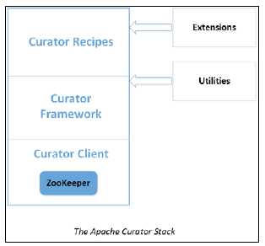
Apache Curator
Curator is a high-level library for ZooKeepes.
Dealing with ZooKeeper much easier and it extends the functionality of core ZooKeeper.
Apache Curator components:
Client: wrapper around ZooKeeper's Java client.
Framework: high-level API with advanced features such as automatic connection management, retrying of operations, and so on.
Recipes: the Curator recipes provide implementations of ZooKeeper recipes;
Extensions: The Curator recipes package implements the common recipes.

Slide 40
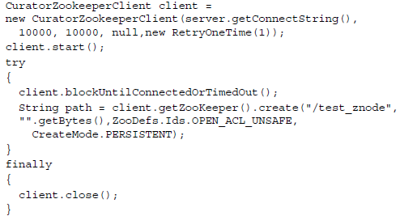
Apache Curator (cont.)
Curator Client is a wrapper around ZooKeeper's Java client.
It makes client access to ZooKeeper much simpler and less error-prone.
The curator client provides the following capabilities:
Connection management: This manages the connection to the ZooKeeper server
Operations retry utilities: This is a mechanism to retry operations
Test ZooKeeper server: This is a ZooKeeper test server for testing

Slide 41
Apache Curator (cont.)
The Curator client supports the following retry policies:
BoundedExponentialBackoffRetry: This retries a specified number of times by increasing the sleep time between the retries up to a maximum upper bound
ExponentialBackoffRetry: This retries a specified number of times by increasing the sleep time between the retries
RetryNTimes: This retries n number of times
RetryOneTime: This retries only once
RetryUntilElapsed: This retries until a specified timeout has elapsed

Slide 42
Apache Curator (cont.)
The Curator framework is a high-level API that simplifies using ZooKeeper to a great extent.
Features provided:
Automatic Connection Management: transparently handles the scenarios where clients need to recreate a connection to the ZooKeeper server and/or retry operations.
Simple and Flexible APIs: This feature applies the raw ZooKeeper API with a set of modern, fluent interfaces.
Recipes: This feature implements common ZooKeeper recipes.

Slide 43
Apache Curator (cont.)
Curator provides a bunch of ready-to-use recipes for ZooKeeper.
Leader election: Curator provides two algorithms for leader election: leader latch and leader selector.
Locks: Shared re-entrant lock, Shared lock,Shared re-entrant read/write lock,Shared semaphore, Multishared lock
Barrier: simple and double barrier.
Counters: manage a shared integer with a shared counter.
Cache: distributed cache
Queues: distributed queue

Slide 44
Apache Curator (cont.)
Exhibitor is a supervisor service to manage ZooKeeper server instances.
Exhibitor is very useful for ZooKeeper instance monitoring, backup/recovery, cleanup, and visualization.
Exhibitor features:
Monitoring: Exhibitor monitors the ZooKeeper server.
Log cleanup: periodically do a cleanup of ZooKeeper logs.
Backup/restore: Exhibitor can be used to back up the ZooKeeper transaction logfile.
Cluster-wide configuration: enables the application of configuration changes to the entire ZooKeeper ensemble by presenting a single system view.
Rolling configuration update: Exhibitor allows hot updating of configuration;
REST API: exposes a REST API that allows developers to write programs to carry out ZooKeeper management tasks.
Visualization: Exhibitor presents a graphical visualization of the ZooKeeper tree.

Slide 45
Zookeeper In Action
ZooKeeper is used by organizations such as Yahoo!, Netflix, Facebook, Twitter, eBay.
Frameworks using Apache Zookeeper:
Apache BookKeeper: distributed logging system
Apache Hadoop: framework that processes large datasets using clusters that span over a large number of nodes
Apache Hbase: distributed, scalable, big data store.
Apache Helix: cluster management framework.
OpenStack Nova: open source software stack for the creation and management of private and public clouds.

Slide 46
Conclussion
Mature technology
Lots of useful features

Slide 47

Bibliography
http://en.wikipedia.org/wiki/Apache_ZooKeeper
Oreilly – ZooKeeper
Apache Zookeeper Essentials

Slide 48
Questions ?

